Slide 1
Dakahlia Governorate Preparatory Certificate Exam Results 2021

Slide 2
Overview
- The project analyzes Preparatory Certificate Exam Results of Dakahlia Governorate.
- Data was extracted from Excel, transformed and loaded into SQL Server using SSIS (ETL process).
- SQL was used for data cleaning, transformation, and calculating percentages.
- Power BI was used to build interactive dashboards with insights at student, school, department, and governorate levels.
- Focuses on success/failure rates, top/bottom schools, and grade distribution.

Slide 3
Used Tools
- Excel → Source exam results data.
- SQL Server → Data cleaning, transformation, and percentage calculations.
- SSIS (SQL Server Integration Services) → ETL process (loading and transforming Excel data into SQL).
- Power BI → Dashboard creation, interactive charts, and KPIs.

Slide 4
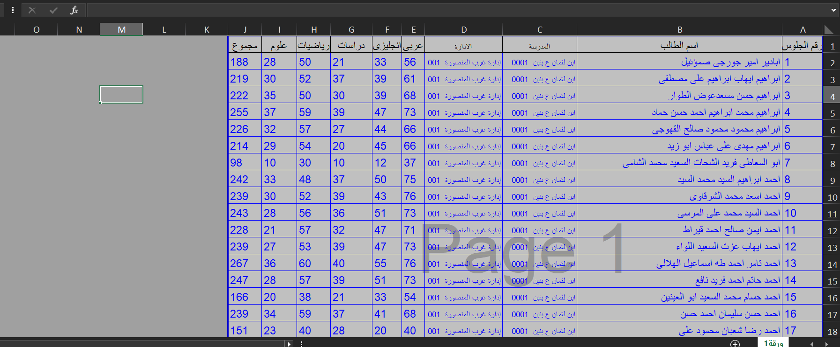
I found an Excel sheet containing the preparatory certificate exam results for Dakahlia Governorate

Slide 5
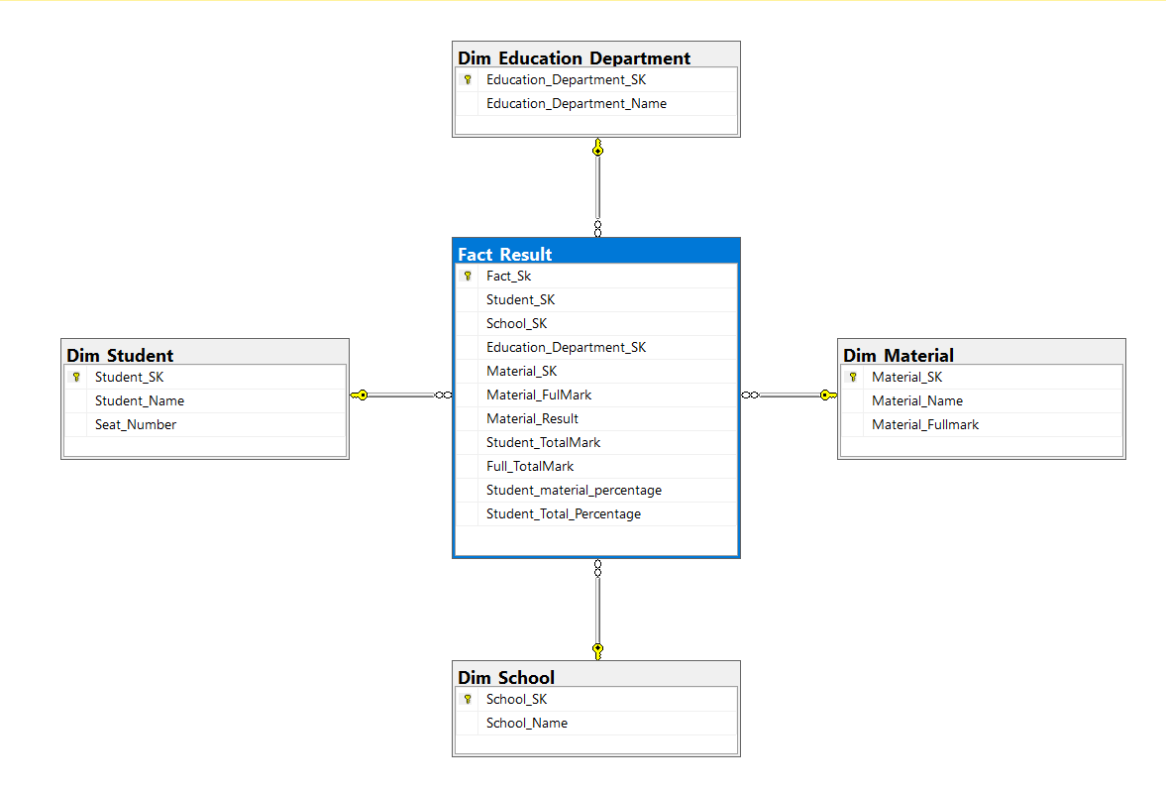
Then in sql server I prepare my fact and dim

Slide 6
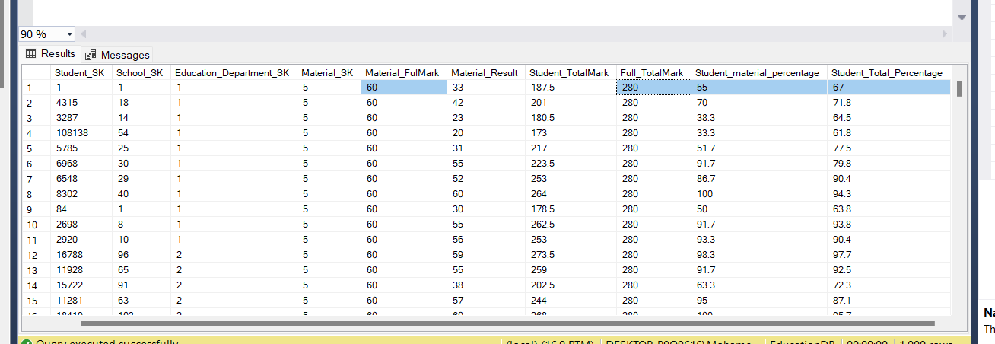
In SQL, I added four additional columns: Material Full Mark – to store the maximum grade for each subject. Student Percentage per Subject – calculated based on the student’s grade relative to the subject’s full mark. Full Total Mark – representing the maximum possible total mark across all subjects. Student Total Percentage – showing the student’s overall performance compared to the full total mark. These columns help in analyzing students’ performance by allowing us to measure both subject-level and overall percentages."

Slide 7
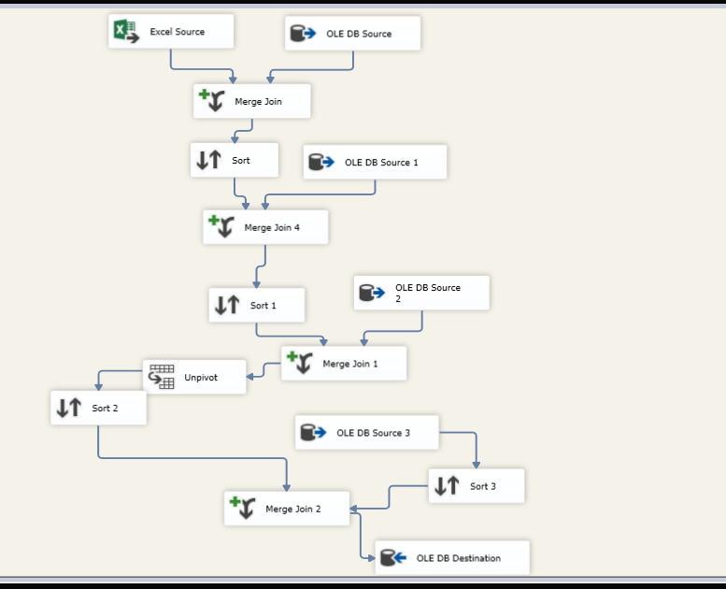
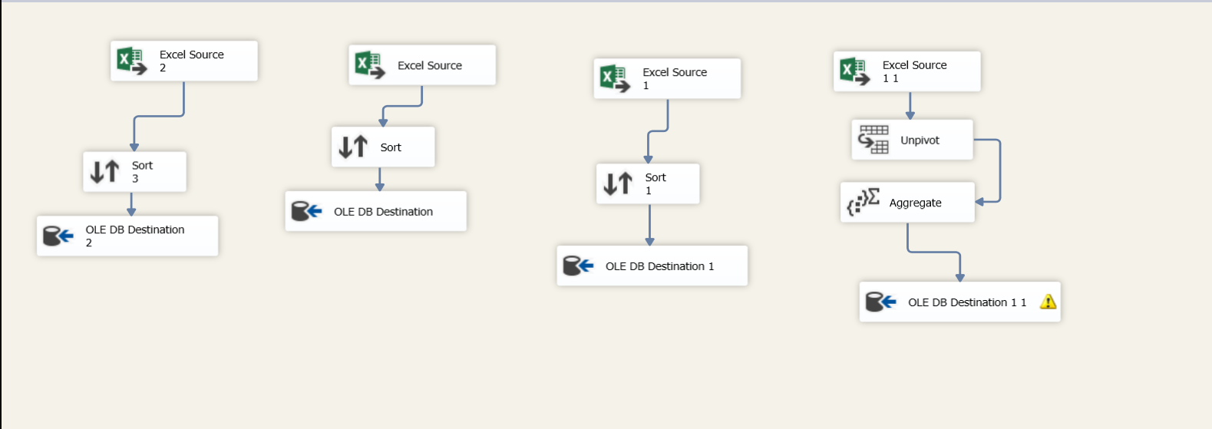
Then using ssis tool to make etl to my data to sql server

Slide 8
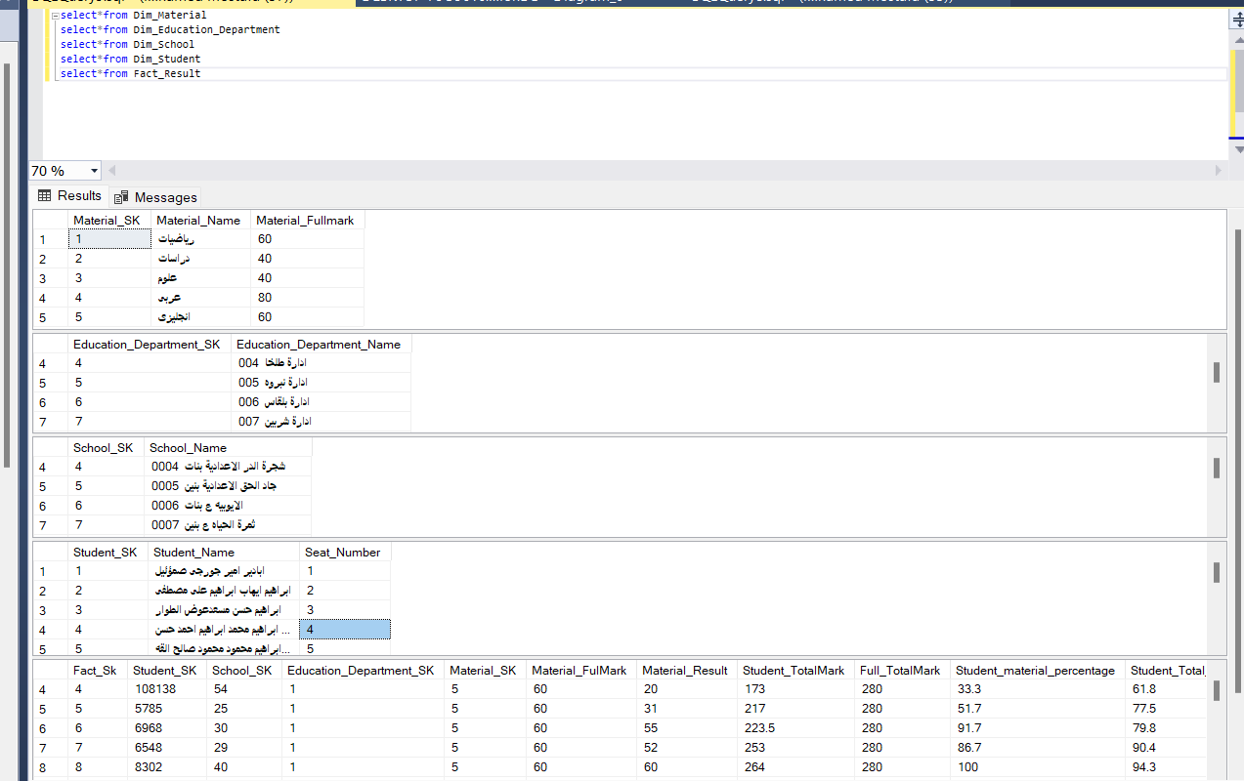
Now my data is ready to analysis

Slide 9
I Make analysis by power Bi Desktop

Slide 10
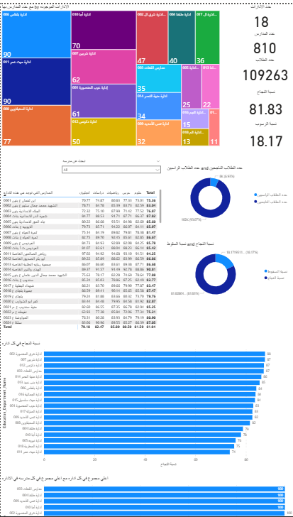
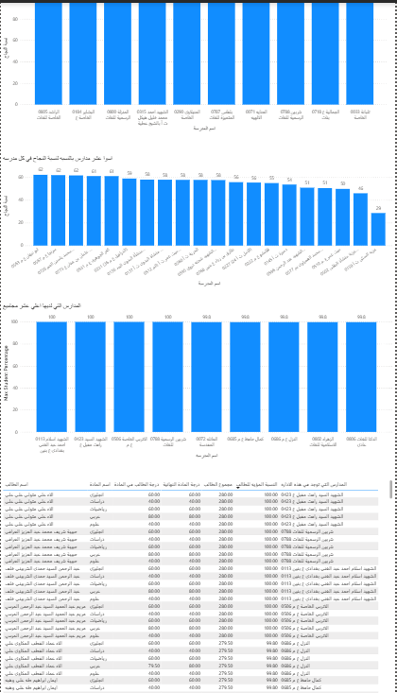
Dashboard

Slide 11
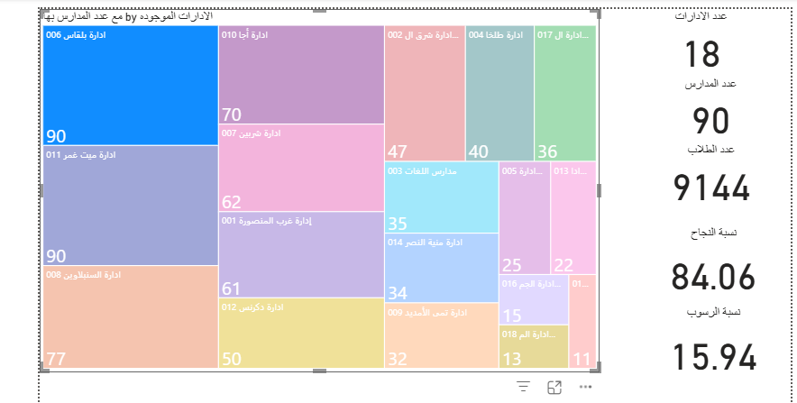
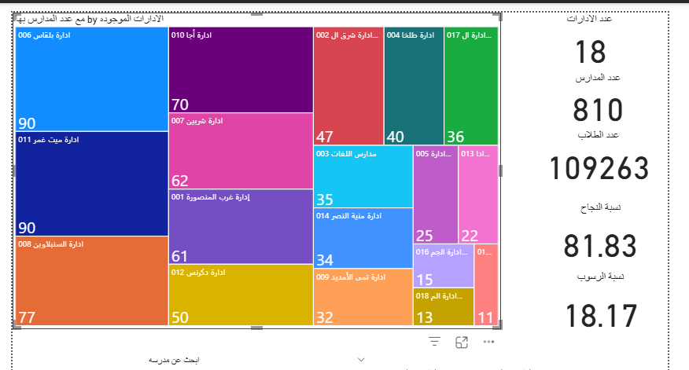
In my dashboard I make treemap have all education department and number of school In that department and I make card to show the total student in all dep and it used also with school or any dep selected and number of dep in that governorate and number of school in all dep and any dep selected and success rate for all governorate or any selected dep or school and also fall rate

Slide 12
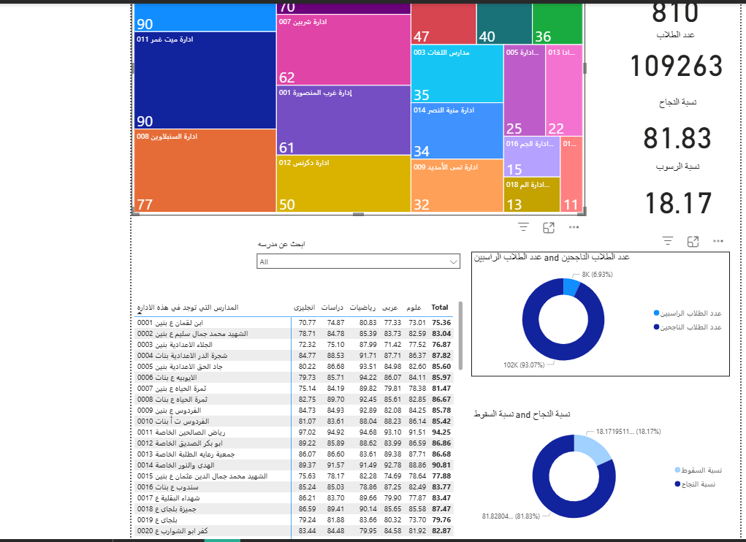
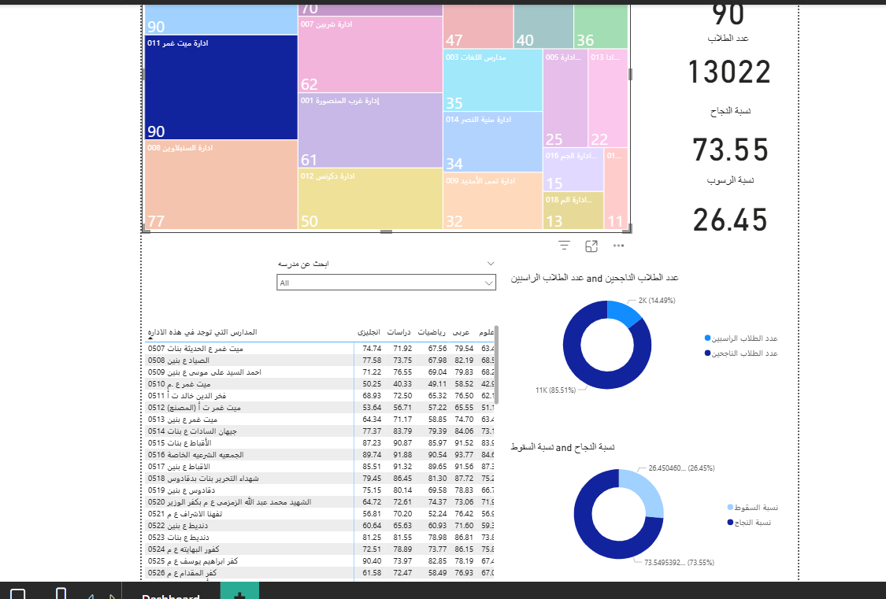
In that dashboard I have also table have all schools in that dep with all succeed rate in all material and success rate and if we press in any dep it only show the schools in that dep and I also have two pie chart one of them to show the count of student have <50 and >50 in all dep and in selected dep or selected school and the other show the success rate and fall rate in all dep ,dep selected and in school selected

Slide 13
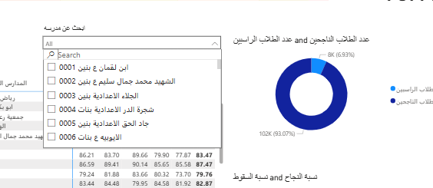
beside I have table to show all school and schools in selected dep I have also dropdown contain all schools and have search button to search in any school we want to show all details about it

Slide 14
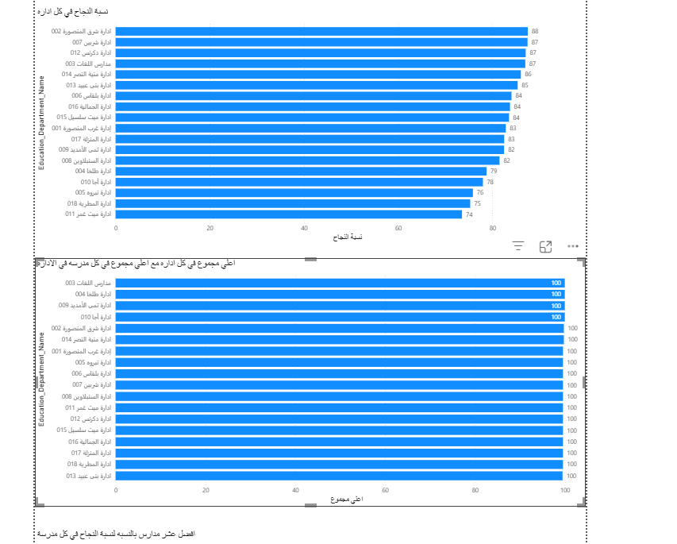
I also have two bar charts: one shows the education department with the highest success rate, and the other shows the maximum grade percentage in each department.

Slide 15
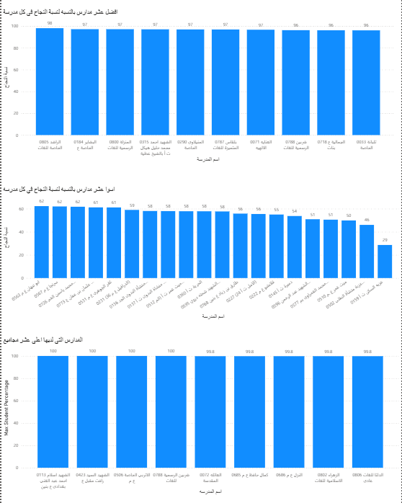
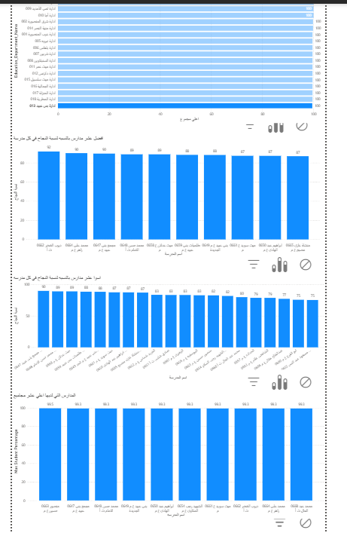
I also have three column charts: Two of them shows the best schools and the worst schools based on success and failure rates, and another shows the top 10 schools where students achieved the highest grades. These charts work for all departments or for a selected department from the treemap or any other department-related chart.

Slide 16
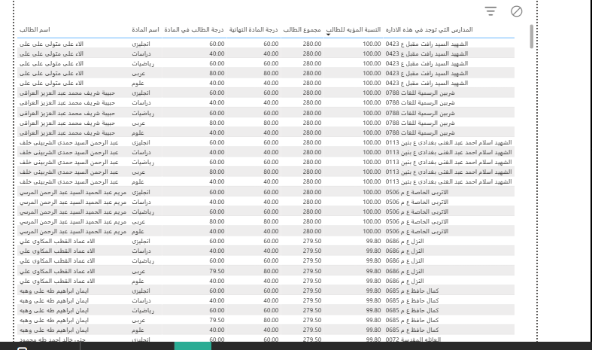
In the last dashboard, I have a table that contains all school details, including student names, grades in all subjects, and the school name. This table is fully interactive with all charts: if a department is selected, it displays all schools in that department with their students’ details; if a school is selected, it shows all details about its students.

Slide 17
Conclusion
- The dashboard enables clear performance comparison across departments and schools.
- It identifies top-performing and underperforming schools.
- Provides detailed student-level insights for decision-makers.
- Helps the education sector in monitoring, evaluation, and strategic planning

